Slide 1
Sociolinguistics Variation
§

Slide 2
Variation
Variable: An abstract representation of the source of variation.
Variant the actual realization of a variable.
Variable
Variant 1
Variant 2
Variant ν

Slide 3
Phonemes
Minimal Pairs
pick, tick, kick, nick, wick,

Slide 4
Allophones
Aspiration:
[p] spin [spin]
/p/
[pʰ] pin [pʰin]

Slide 5
What is free variation? Is it really free?
Provide examples:
the word stop may be pronounced with a plain unaspirated [p], [stɒp], or with a glottalized [pˀ], [stɒpˀ]

Slide 6
Nasality
[pende]
/pende/
[peⁿde]
[pede]

Slide 7
What is a variable?

Slide 8

Cause and Effect

Slide 9
Remember!!!!
Independent Variables (Cause)
Gender
Social Class
Age
etc.
Dependent (Effect)
The thing we measure!!!

Slide 10
Provide Examples from your experience
Phonetics,
Phonology
Morphology
Syntax
Semantics
Pragmatics
Vocabulary

Slide 11
Variation
GRAMMAR
Multiple Negation (informal spoken English)
so it’s nice, you know: my younger brother hasn’t got no children, but that’s, that’s his decision
Multiple negation – the use of two or sometimes several negative markers in a statement – often provokes disapproval, and is viewed by many speakers as somehow illogical: two negatives surely do not make a positive?

Slide 12
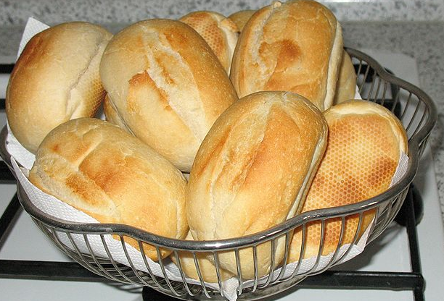
Variation
VOCABULARY
Do you call a ‘bread roll’ a cob, batch, bread cake, barm cake or a scuffler (Yorkshire)?
The original barm cake is found in areas of Lancashire, North West England. In wider northern England, a similar bread roll would be known instead as a "breadbun", "breadcake", "bap", "cob" (an East Midland term), "teacake" (West Yorkshire/some parts of Cumbria; without currants or currant teacake with currants) or even (in the enlarged form of Tyneside) a "stotty".

Slide 13
Variation
Received Pronunciation
Received Pronunciation ( RP) is the proper term to describe the regionally neutral accent used by many middle class speakers in England. It is widely used as a reference point in dictionaries and as a model for teaching English as a foreign language. But have you ever wondered how it came into existence, how it is changing or what role it plays in 21st century Britain?
Geordie dialect
The UK has a number of distinctive dialects, and Geordie – the dialect of Newcastle-upon-Tyne – is arguably one of the most recognisable.
Minority ethnic English
For more than half a century, immigrants from the Indian subcontinent and the West Indies have added variety and diversity to the rich patchwork of accents and dialects spoken in the UK.

Slide 14

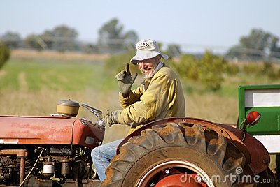
Why we talk differently?

Slide 15

Social Reasons
Age
Occupation
Education
Can you think some more?
Do you notice important differences in your friend’s talk?

Slide 16
Stereotypes
Markers
Indicators

Slide 17
Gumperz (1972: 205)
communicative competence

Slide 18
Thank you

